Slide 1

01
AGRICULTURAL STRATEGY • INDIA & GUJARAT
Better Farmers • Healthier People • Stronger India
From
Chemicals
to Change
Sustainable Farming for
a Healthier Tomorrow
Sustainable Yield
Farmer Prosperity
➔
01

Slide 2

02
Is Cancer
only because of
tobacco?
Tobacco, alcohol and lifestyle are major factors, but they are not the only documented concerns.
01
Tobacco
02
Alcohol
03
Pollution
04
Processed
Diet
05
Chemical
Residues
Source: Documented etiology by WHO, IARC & ICMR NCRP.

Slide 3
03
Rising Cancer Cases
in India
Key Agronomic Shifts
15.7
Lakh
• Rapid adoption of synthetic nitrogen & chemical pesticides since 1970s
13.9
Lakh
11.6
Lakh
• India emerged as a massive high-growth target market for agrochemical giants
7.8
Lakh
• Short-term yield spikes coupled with long-term soil carbon depletion
• Growing scientific consensus on reducing avoidable occupational chemical exposure.
2010
2015
2020
2025
(Est.)

Slide 4
04
The Hidden Cost
of Chemical Farming
Every season, recurring operational expenditure is drained by:
The 1-Year Investment Pivot
If an Indian farmer redirects just ONE year of recurring poison spend, that capital—combined with state subsidies—funds a high-tech Polyhouse or precision Drip irrigation system.
Fertilizers
Pesticides
Growth Boosters
Soil Conditioners
Synthetic NPK
and DAP
Chemical sprays
& insecticides
Synthetic growth
hormones
Chemical pH &
salt additives
₹
₹
₹
₹
Same Capital Reallocation ➔ Long-Term Farm Asset

Slide 5
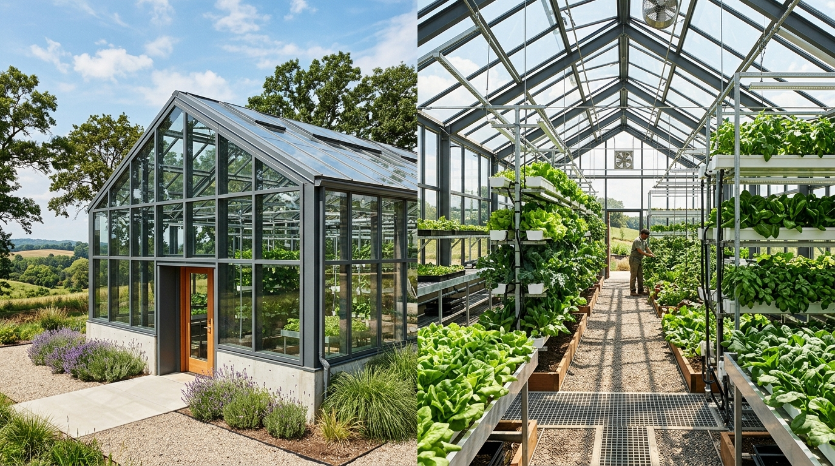
05
What is a Greenhouse?
A greenhouse is an engineered micro-climate structure designed for protected agriculture. Utilizing glass or structured polycarbonate, it eliminates climate volatility and delivers complete environmental control.
Micro-Climate
Regulation
365-Day Year-Round
Harvest Cycles
Export-Grade
Blemish-Free Crop

Slide 6
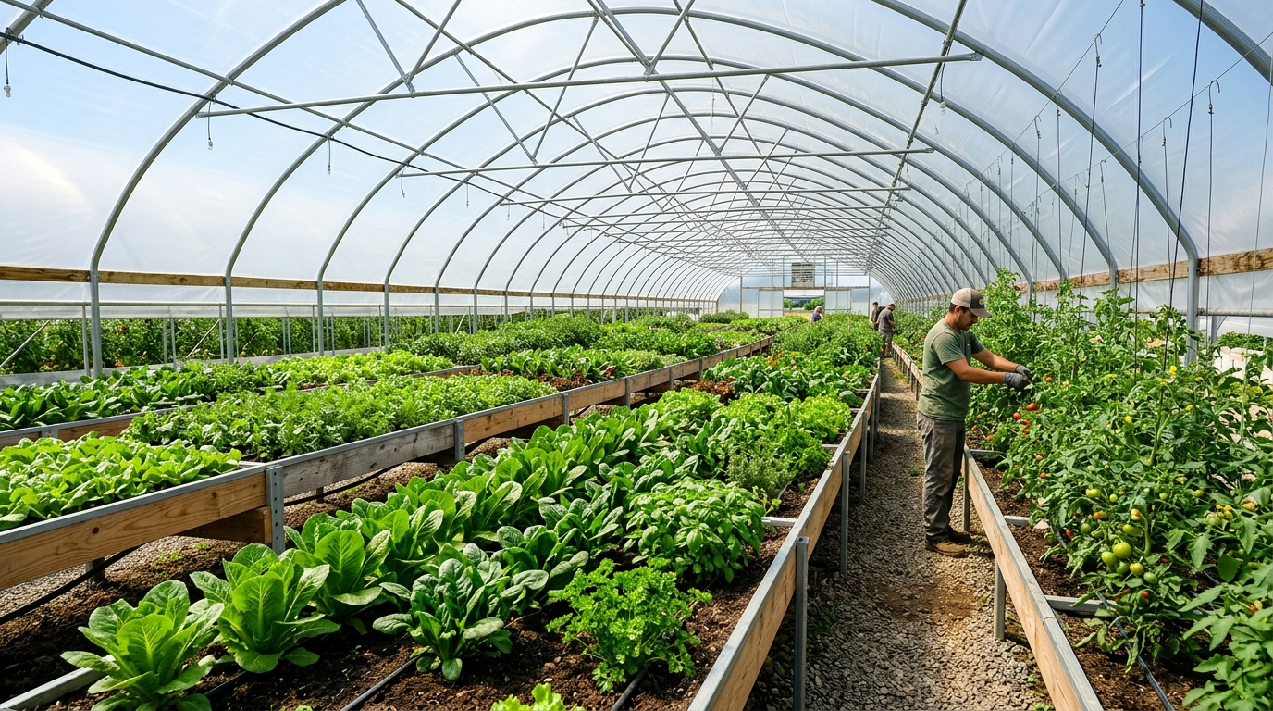
06
What is a Polyhouse?
A polyhouse is a cost-effective greenhouse variant sheathed in UV-stabilized polyethylene film over a galvanized iron (GI) frame. Extensively adopted across Gujarat, Maharashtra, and North India with up to 75% subsidy support.
High ROI
Capital Efficiency
Engineered for
Indian Climate
Modular & Low
Maintenance

Slide 7
07
Polyhouse vs. Greenhouse: Architectural Comparison
Technical Feature | Polyhouse System | Commercial Greenhouse
Covering Material | 200-micron UV-stabilized Polyethylene | Toughened Glass or Multiwall Polycarbonate
Capital Expenditure | Accessible (₹750 – ₹1,100 / sq. meter) | High Capital (₹2,500 – ₹5,000 / sq. meter)
Environmental Control | Semi-Controlled (Fan & Pad, Naturally Ventilated) | Fully Automated Closed Micro-climate
Structural Durability | GI Frame: 20+ yrs; Polyfilm: 5–7 yrs | Heavy Steel / Aluminum: 25+ years
Primary Commercial Use | Vegetables (Capsicum, Tomato, Cucumber), Spices | High-tech Floriculture, R&D, Exotic Seed Breeding
Indian Practical Adoption | Widely scaled in Gujarat, Maharashtra & HP | Specialized corporate / institutional projects

Slide 8

08
Can Protected Farming
Be 100% Organic?
• Yes. Protected cultivation and certified organic methods are natural commercial partners.
• Biological Pest Control: Insect-proof netting, yellow/blue sticky traps, and neem bio-extracts prevent chemical sprays.
• Organic Nutrition: Micro-dosing vermicompost slurry, Jeevamrut, and enriched bio-fertilizers via drip.
• Accredited Certification: Compliant with NPOP (National Programme for Organic Production) & PGS-India.
• Zero Residue Advantage: Captures commanding 30%–50% price premiums in Tier-1 metros and export markets.
Living Soil • Clean Food • Healthy Families

Slide 9
09
The Agri-Business Transformation: Complete 7-Stage Chain
Transitioning the Indian farmer from a price-taking grower into an integrated agri-business enterprise
1. Land
Soil & Drip
2. Production
Polyhouse/IPM
3. Storage
Cool Crates
4. Processing
Grading/Value
5. Branding
Packaged/FSSAI
6. Market
FPO/Direct
7. Customer
Full Value
➔
➔
➔
➔
➔
➔
THE COMMODITY TRAP (Stopping at Stage 2)
MODERN AGRI-BUSINESS MODEL (Stages 1 through 7)
• Farmer sells uncleaned raw crop at farm gate or APMC distress auction
• Raw Wheat: ₹22–25/kg | Raw Groundnut: ₹55–60/kg
• Bulk produce sold for pennies during seasonal glut
• Multiple intermediaries capture 70% of consumer expenditure
Outcome: Farmer carries 100% production risk, captures only 25% consumer rupee
• Wheat Model: Cleaned, stone-ground Chakki Atta in 5kg bags: ₹60/kg (vs ₹24 raw)
• Groundnut Model: Graded roasted snack packs or cold-pressed oil: ₹200/kg (vs ₹55 raw)
• Horticulture: Direct crate contracts with urban supermarkets & restaurants: 3x profit
Outcome: Farmer captures 65%–85% of consumer rupee directly through FPO / retail linkages

Slide 10
10
6-Phase Implementation Roadmap
01
02
03
04
05
06
Crop Planning &
Market Feasibility
GI Polyhouse
Structure Setup
Precision Drip &
Fertigation Lines
Biological Inputs &
IPM Netting
Micro-Climate &
Canopy Tracking
Grading, Packing &
Direct Selling

Slide 11
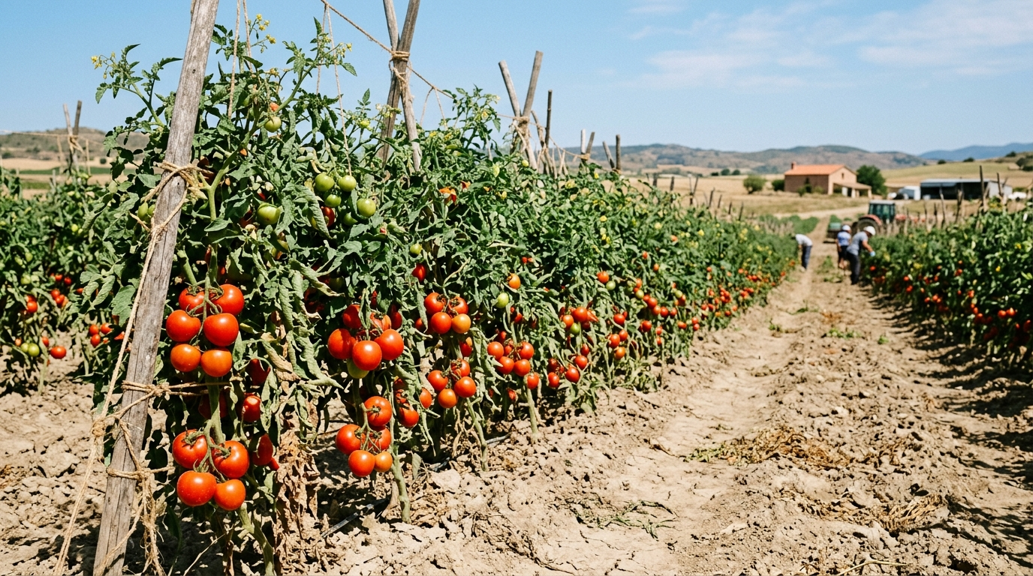
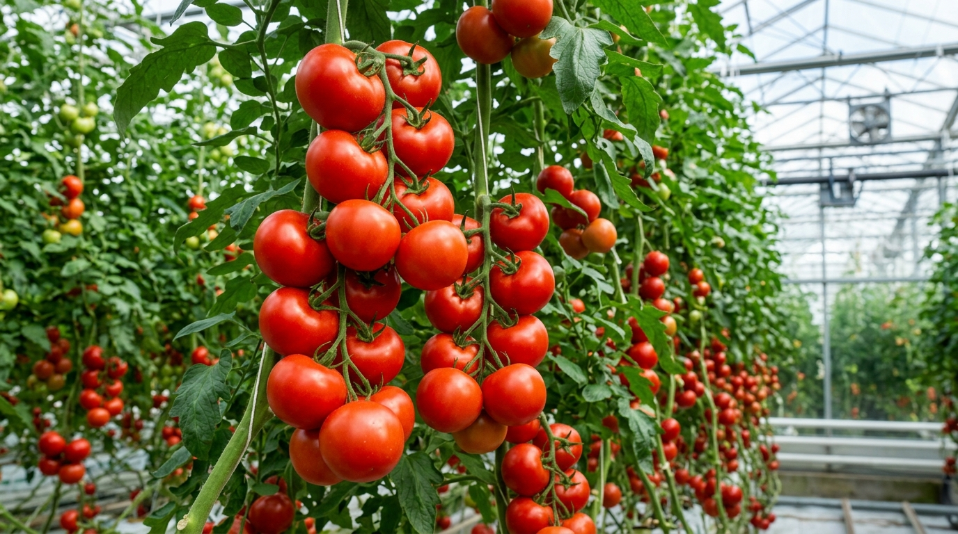
11
Real Field Benchmark: Tomato Cultivation
Open Field Cultivation (Traditional)
Protected Polyhouse Cultivation (Integrated)
• Yield: 25–30 tons / acre
• Realized Price: ₹10–₹15 / kg (Glut)
• Gross Revenue: ₹3.0 – ₹4.5 Lakh / acre
• Net Margin: Moderate (Pest losses up to 35%)
• Yield: 80–100 tons / acre (3.5x Multiplier)
• Realized Price: ₹40–₹60 / kg (Controlled Off-Season)
• Gross Revenue: ₹32.0 – ₹60.0 Lakh / acre
• Key Advantage: Vertical growth, blemish-free grade

Slide 12
12
Market Economics: The Power of Seasonality
When market supply contracts while urban consumer demand remains constant, farm-gate realization surges exponentially.
Price (₹) ↑
[Controlled Off-Season Harvest: ₹40-60/kg]
[Peak Open Field Glut: ₹10/kg]
Market Supply →
• Controlled Off-Season Harvesting
• Bypassing Conventional Harvest Gluts
• Consistent Quality Commands Premium Pricing
• Higher Farm Margin with Less Total Acreage

Slide 13

13
1-Acre Financial P&L: Economics & Margins
Net Return = Gross Revenue − (Inputs + Labour + Irrigation + Transport)
Financial Metric | Traditional Field | Smarter Diversified | High-Tech Polyhouse
Capital Setup | ₹50,000 | ₹75,000 (Drip & beds) | ₹8,00,000 (Net after Subsidy)
Annual Input Cost | ₹60,000 (Chemicals) | ₹62,000 (Organic/FPO) | ₹6,50,000 (Biologicals)
Yield per Acre | 15–20 tons | 22–26 tons | 80–100 tons (3.5x Multiplier)
Avg Realized Price | ₹15–₹20 / kg | ₹26–₹30 / kg | ₹45–₹60 / kg (Peak Off-Season)
Gross Revenue | ₹1,00,000 | ₹1,30,000 | ₹36,00,000 – ₹45,00,000
Net Profit / Acre | ₹40,000 | ₹68,000 (+70% jump) | ₹25,50,000+ Net Profit
From Raw Commodity Price-Taker
to High-Margin Farm Enterprise
+₹28,000 more net margin on same open land — and ₹25 Lakh+ in protected cultivation!

Slide 14
14
The 5 Big Levers for Farm Profitability
Strategic levers to maximize net return per acre without expanding landholding size
Lever 1
Lever 2
Lever 3
Lever 4
Lever 5
High-Value Crop
Selection
Disintermediate
Supply Chain
On-Farm Value
Addition
Diversified
Revenue Streams
Input Cost
Rationalization
Shift acreage from low-margin bulk commodities (cotton/castor) to spices, seed crops, and protected vegetables.
Bypass 3–4 middlemen through FPOs, farmer cooperatives, supermarket contracts, and direct urban farmers' markets.
Participate in downstream value: Cleaned wheat ➔ Packaged Atta (₹60/kg); Groundnut ➔ Roasted snack packs (₹200/kg).
Insulate cash flow: Cash crop + Polyhouse horticulture + Dairy integration + Vermicompost packaging + Nursery seedlings.
Eliminate ₹80,000 chemical spend with on-farm Jeevamrut; prevent water waste with drip; buy inputs collectively in FPO.

Slide 15

15
Government Subsidies & Gujarat Income Roadmaps
Structured pathways to ₹5 Lakh, ₹10 Lakh, and ₹20+ Lakh annual farm income
MIDH / NHM & i-Khedut
NABARD & FPO Grants
NPOP & PGS-India
50% to 75% Capital Subsidy on Polyhouse, Mulching & Precision Drip
Grants for Village Packhouses, Sorting Units, Cold Storage & Working Capital
Official Organic Certification for 30%–50% Domestic & Export Price Premium
₹5 Lakh / Year Model
₹10 Lakh / Year Model
₹20+ Lakh / Year Model
0.5 Acre Polyhouse + Open Field: Off-season tomato/cucumber + Cumin/Groundnut + Vermicompost unit (selling 5 tons/yr).
1 Acre Polyhouse: 2 cycles (Colored Capsicum + Off-season Cucumber) + Direct supply contracts to city retail chains.
Integrated Agri-Business: 2+ Acres Polyhouse + Village Sorting/Packhouse + Branded Atta/Peanuts + FPO aggregation.
“With structured technology, value addition, and policy support, Indian farmers transition from vulnerable price-takers to thriving agri-entrepreneurs.”

Slide 16
Healthier Farms
Happier Families
A Stronger India
Building a sustainable,
profitable, and resilient
future for Indian agriculture.
Farmers
Food Security
Public Health
Ecology
Prosperity
16

